Slide 1


Critical Design Review
December 9th, 2015
F l y N e t
Drew Ellison
Austin Anderson
Bryce Hill
Steve McGuire
Prashant Ganesh
Ed Meletyan
Tyler Clayton
Matt Busby
Taylor Dean

Slide 2
Presentation Overview
Team Organization
Concept of Operations
System Design Overview
Subsystem Overviews:
Hardware
Planning
Flight Controls
Perception
SLAM
Target Identification

Slide 3
Organizational Chart
Drew Ellison
Project Manager
Steve McGuire
PerceptionLead
Bryce Hill
PlanningLead
Ed Meletyan
Simulation Lead
Austin Anderson
Systems Engineer
Taylor Dean
Perception Team
Tyler Clayton
Hardware Lead
Matt Busby
Test Lead
Prashant Ganesh
Hardware Team

Slide 4
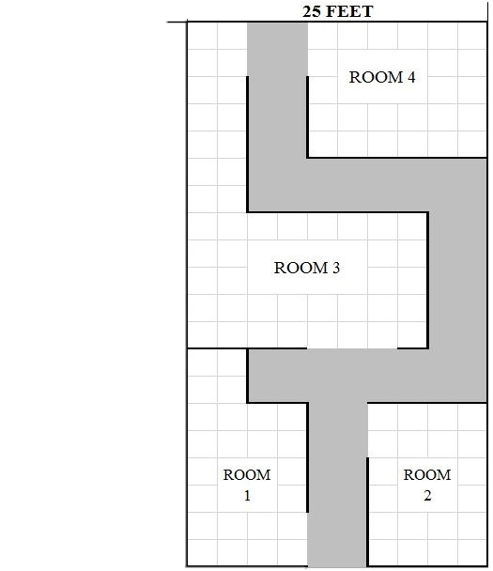
Presentation Overview
Autonomously explore an indoor environment with a team of ground/air robots in a disaster area situation
Map the environment and communicate that map to first responders
Identify humans in the environment and report their locations to first responders
Deliver a package to humans in the environment
“Roadblock”
“Target”
“Complete Block”
Entry/Exit Point

Slide 5
Presentation Overview
= Internal Software hosted on XU4
FLiR
Ground Station
= Off board system
= Sensor
Target Detection and Tracking
= Pixhawk
Guidance
SLAM
Planning
Flight Control
RC Overrides
= Internal software connection using ROS publish/subscribe
= SPI Video
= USB connection
= Wireless link

Slide 6
Presentation Overview
Main Node
Converter Node
Hardware
ROS Topic
Quadrotor
Motor PWM
Pixhawk
Position Setpoint
MAVROS
Dynamics
Fused Pose Data
Pose → Odom.
Pixhawk Pose Estimate
(x, y, z, ϕ, θ, ψ)
Fused Odometry
(v_{x}, v_{y}, v_{z})
Guidance
OctoMap
RTAB Map
Visual Odometry
(v_{x}, v_{y}, v_{z})
OctoMap → 2D Map
Guidance Node
Grayscale Images
SLAM Pose
(x_{map}, y_{map}, z_{map)}
2D Occupancy Grid
Obstacle Distance
(fused range x 5)
Setpoint Position/Attitude
(x_{set}, y_{set}, z_{set} ϕ_{set}, θ_{set}, ψ_{set})
Planning Nodes

Slide 7
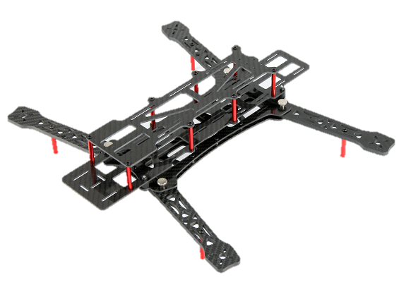
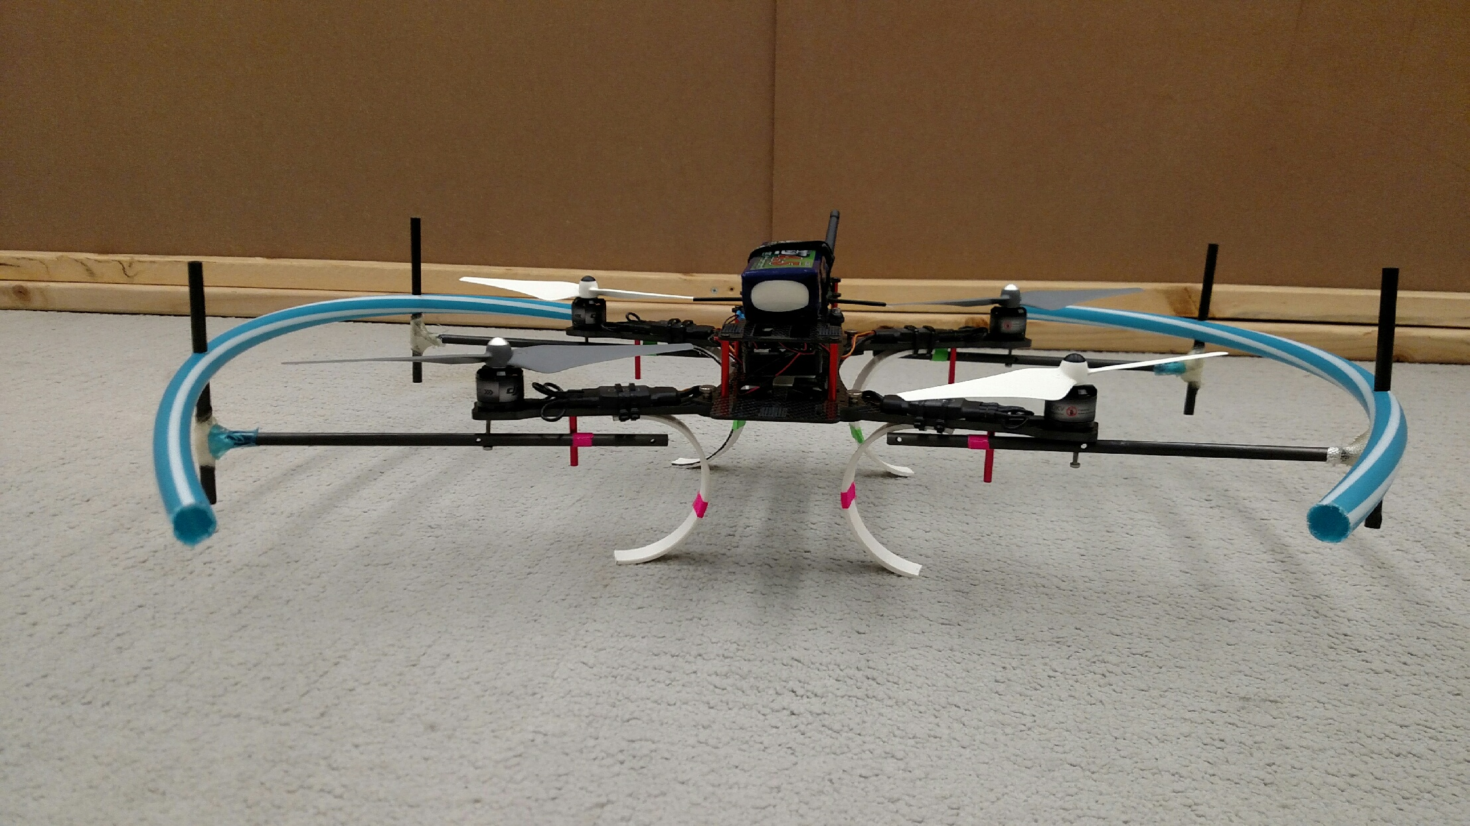
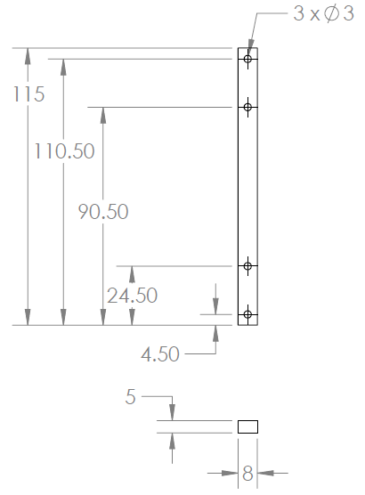
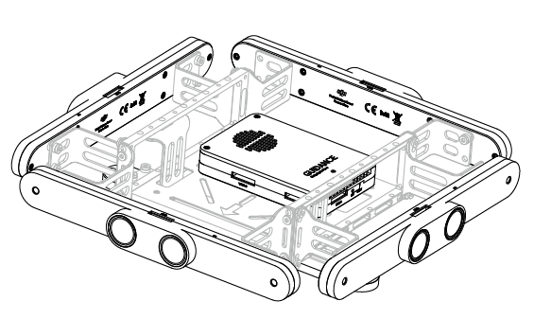
Quad Structure
Holes for Custom Guidance Mount
Stereo Camera Pair
Ultrasonics

Slide 8
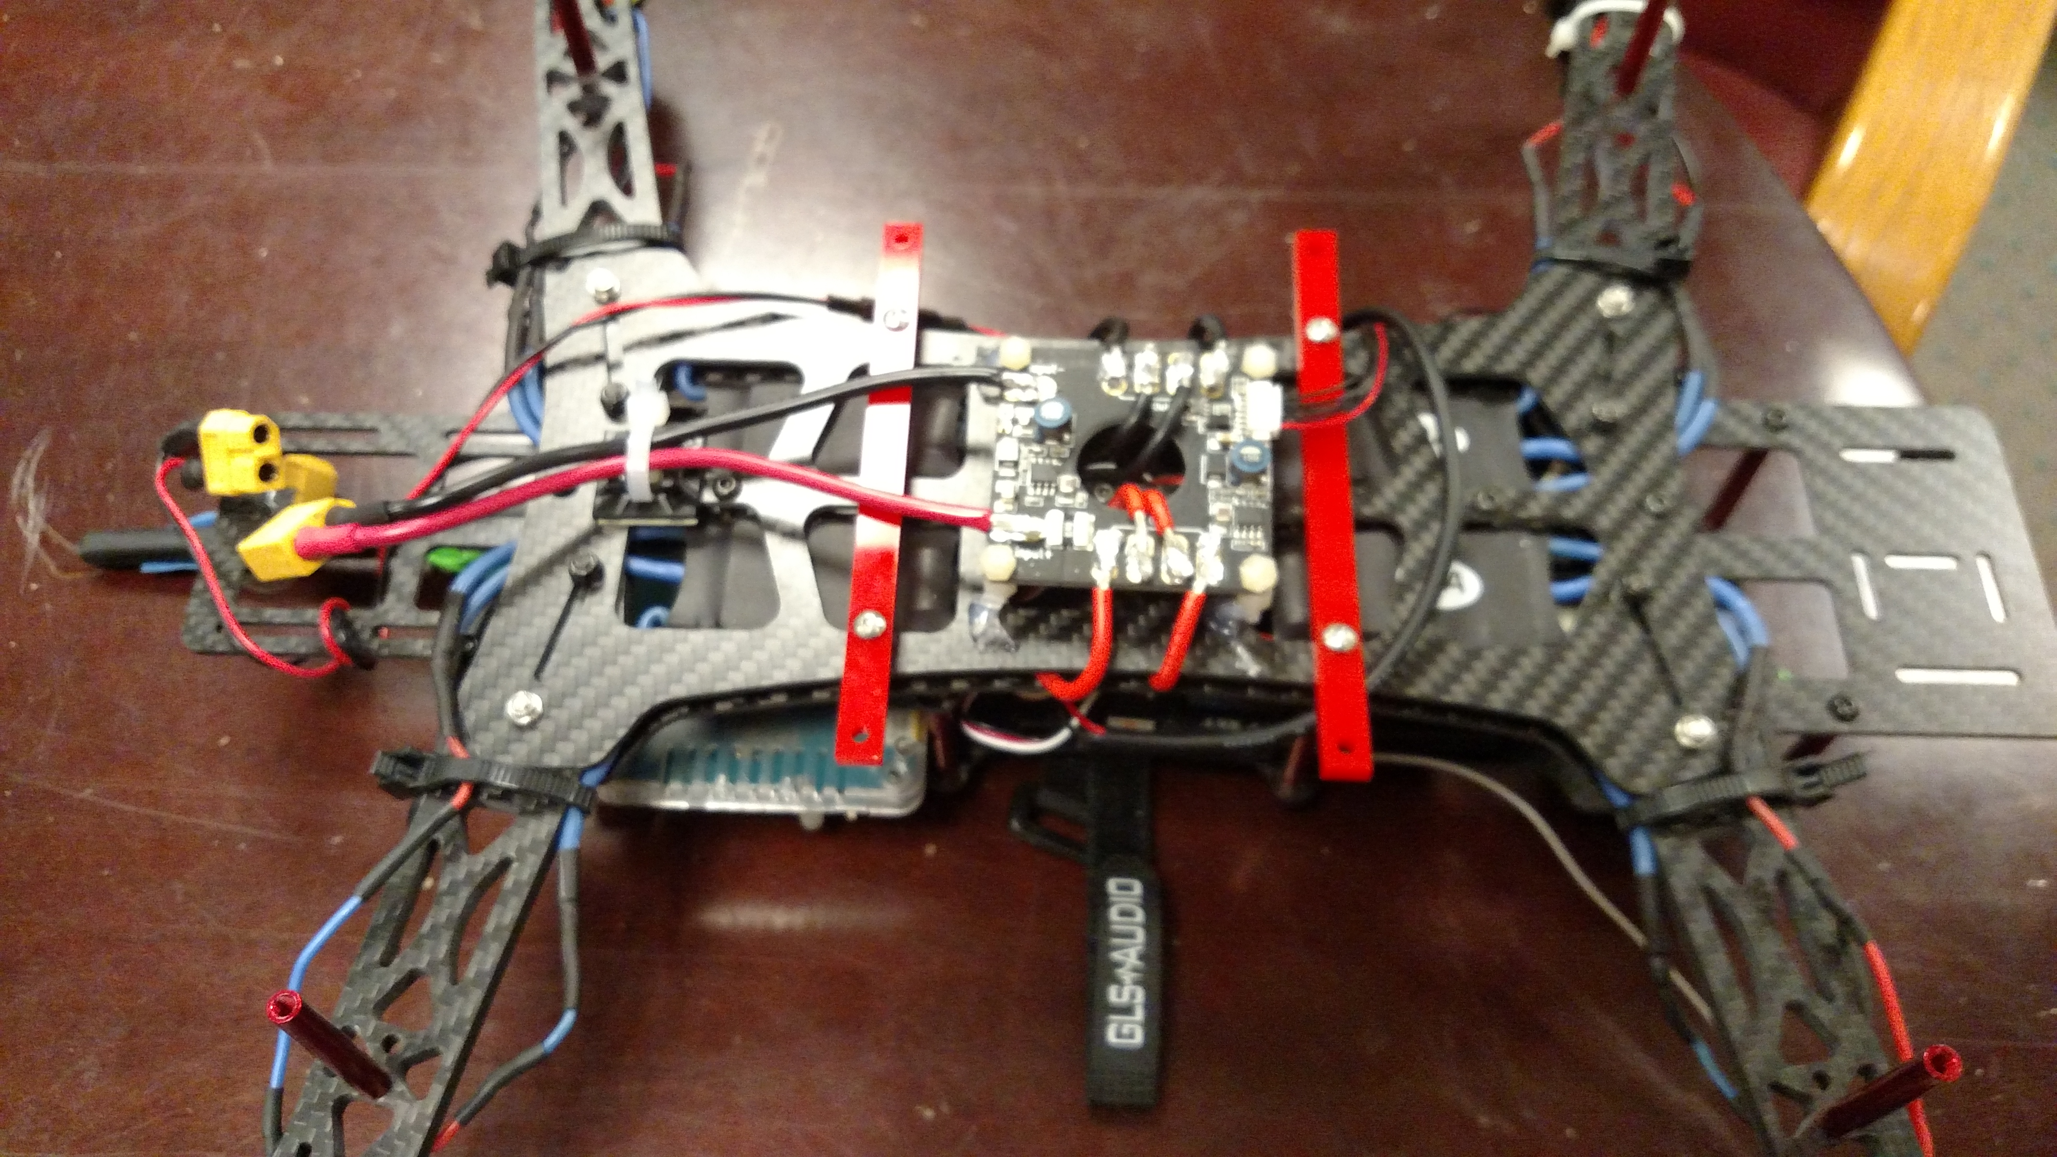
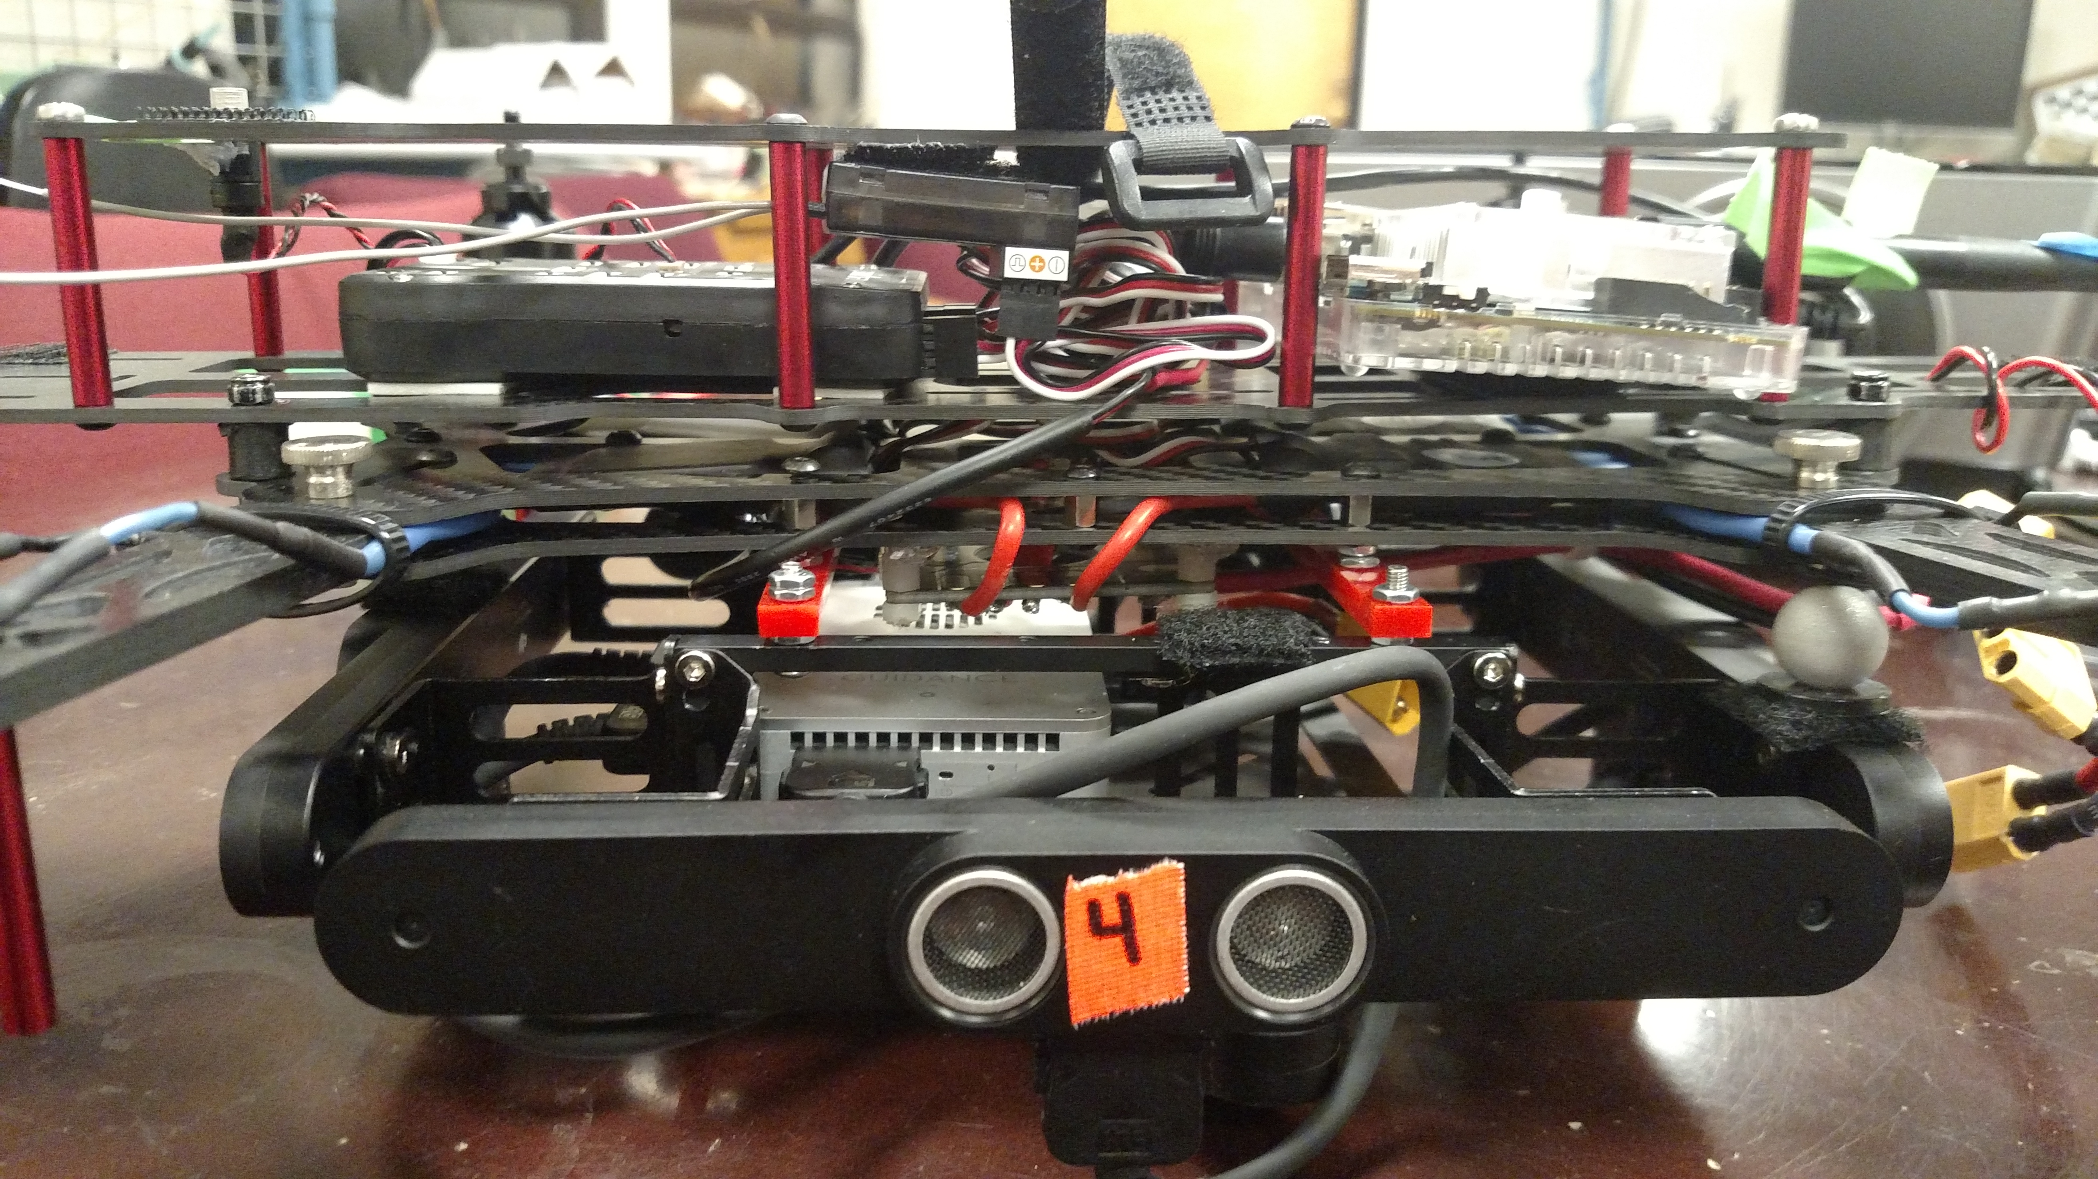
Quad Structure
Underside of quad with Guidance sensor mounting bars
(red)
Guidance Sensor attached to quadcopter

Slide 9
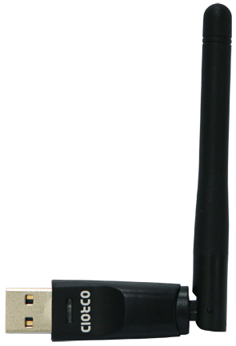
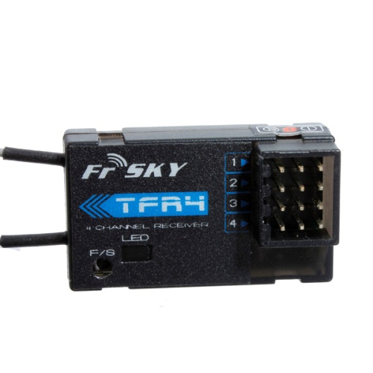
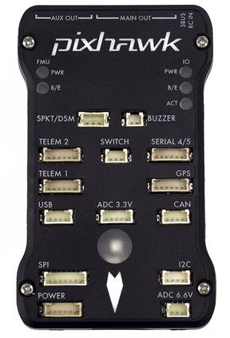
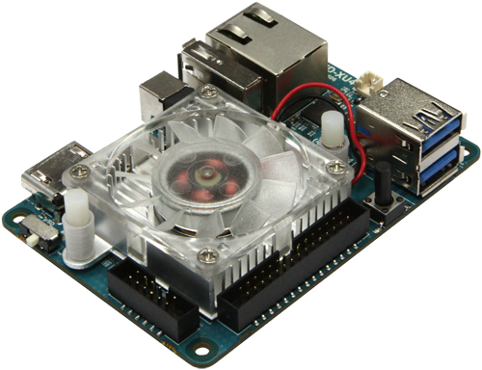
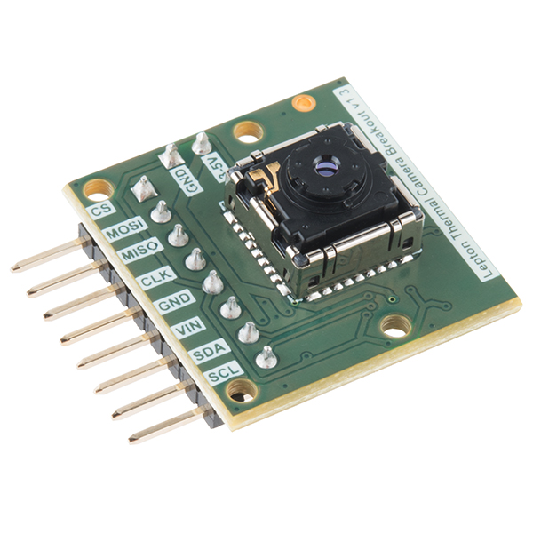
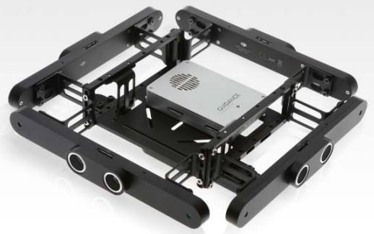
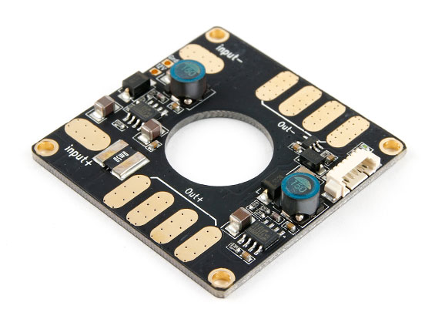
Quad System Design
FrSKY TFR4 Radio Receiver
Comms
Power
UART
(RC inputs)
WiFi Adapter
USB 3.0 (#0)
USB 2.0 (#1)
(Position
Commands)
SPI (video)
I2C (control)
Pixhawk with PX4 Firmware
FLiR Sensor
ODROID XU4
PWM Signals
USB 2.0 (#2)
(odometry & BW images)
ESC/ Motor
Battery (14.8V)
DJI Guidance

Slide 10
Mass Budget
Component | Qty | Mass (each) [g]
AlienCopter Bee Frame | 1 | 303.0
Custom Landing Gear | 4 | 22.5
Custom Propeller Guards | 2 | 123.0
ODROID XU4 (w/ case and Wi-Fi dongle) | 1 | 83.5
ODROID Expansion Shield | 1 | 21.1
DJI Guidance Sensor (w/ mounting hardware) | 1 | 470.4
Pixhawk | 1 | 40.3
FliR Lepton LWIR Camera | 1 | 0.6
FrSKY TFR4 Radio Receiver | 1 | 8.7
Power Distribution Board | 1 | 21.0
SunnySky V2216-12 II Motors | 4 | 68.7
10x4.7 Propellers | 4 | 11.1
20A ESC | 4 | 28.4
Turnigy Multistar 4S 10.0 LiPo Battery Pack | 1 | 815.8
 | Total | 2365.3

Slide 11
Power Distribution FBD
FLiR
WiFi Dongle
ODROID
Battery (14.8V)
5V
Regulator
14.8 V , .81 A
Guidance
5 V , 4 A
Pixhawk
Power Distribution
5 V , 0.3 A
14.8 V , 2-20 A
Radio Receiver
ESC
14.8 V
Motors

Slide 12
Power Budget
Component | Qty | Nominal Voltage [V] | Current Draw [mA] | Power Consumption [mW]
ODROID XU4 (powers FLiR & Wi-Fi) | 1 | 5 | 4000 | 20000
DJI Guidance Sensor | 1 | 14.8 | 810 | 12000
Pixhawk (powers radio receiver) | 1 | 5 | 300 | 1500
SunnySky V2216-12 II Motors | 4 | 14.8 | 4730 | 70017
Total |  |  | 24030 | 313568
Motors use 89.3% of total power consumption (78.7% of Current Draw)
Motor estimated at hovering condition

Slide 13
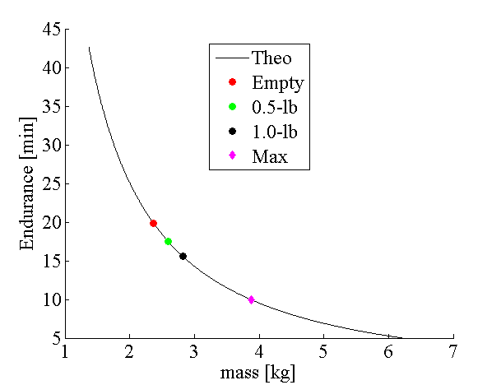
Flight Endurance
Mass [kg] | Time [min]
2.37 | 20
2.60 (0.5 lb) | 17.5
2.82 (1.0 lb) | 15.6
3.87 (MAX) | 10
Note, all data points shown above are theoretical

Slide 14
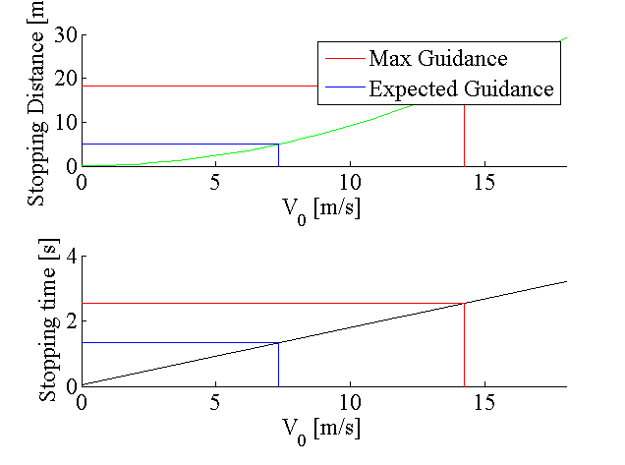
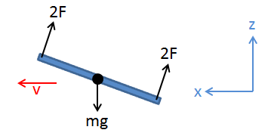
Stopping Distance Simulation

Slide 15
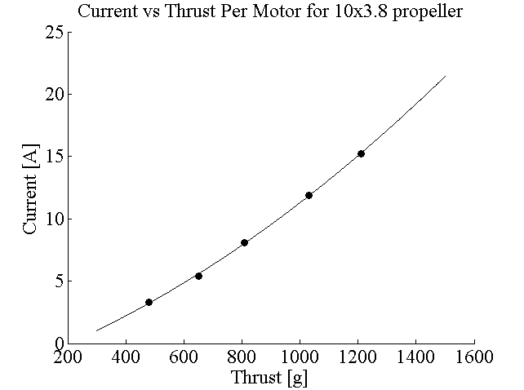
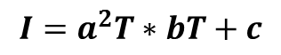
Motor Current Estimation
Experimental Results of SunnySky V2212 Motors
Propeller | Throttle | Current Draw [A] | Thrust [g]
10x3.8 | 50% | 3.3 | 480
 | 65% | 5.4 | 650
 | 75% | 8.1 | 810
 | 85% | 11.9 | 1030
 | 100% | 15.2 | 1210
Experimental results were found for 10x3.8 propeller
Quadratic fit to get an equation for current depending on thrust
a | 4.72E-06
b | 8.50E-03
c | -1.947
$$I=a^{2}T∗bT+c$$

Slide 16
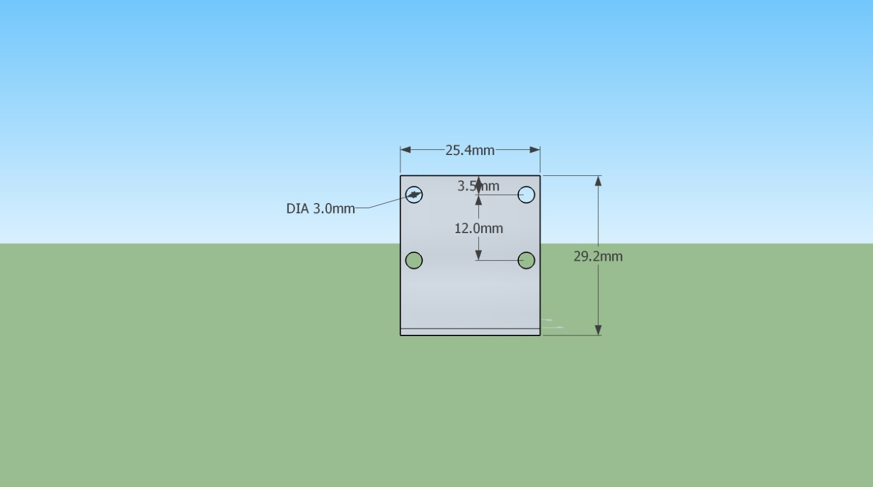
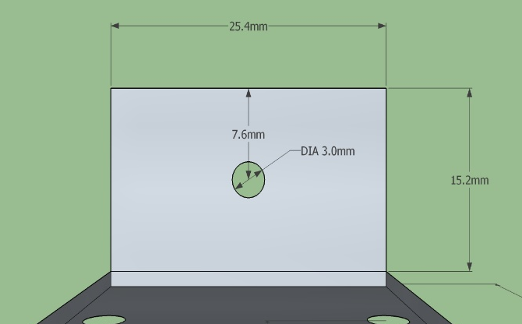
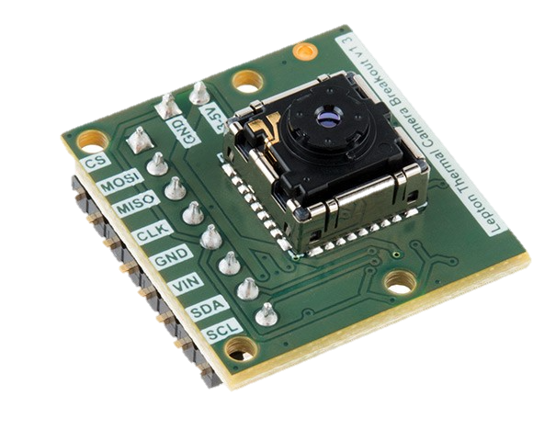
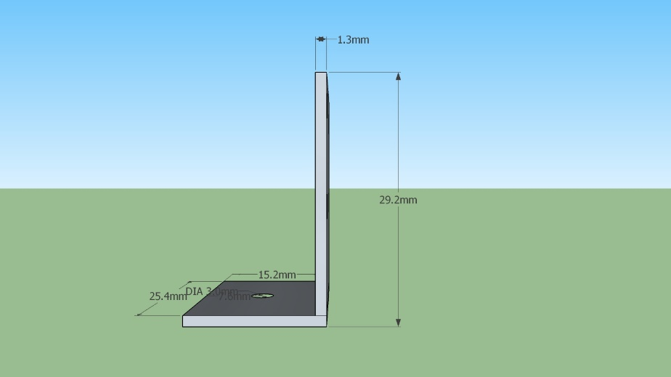
FLiR Sensor Mounting
Aluminum Bracket:

Slide 17
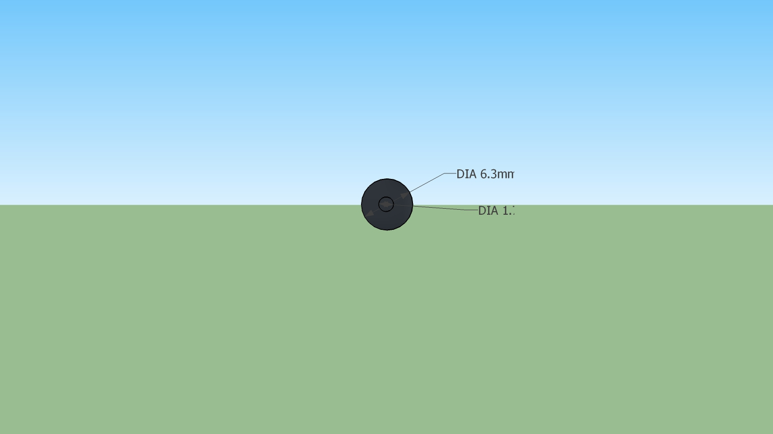
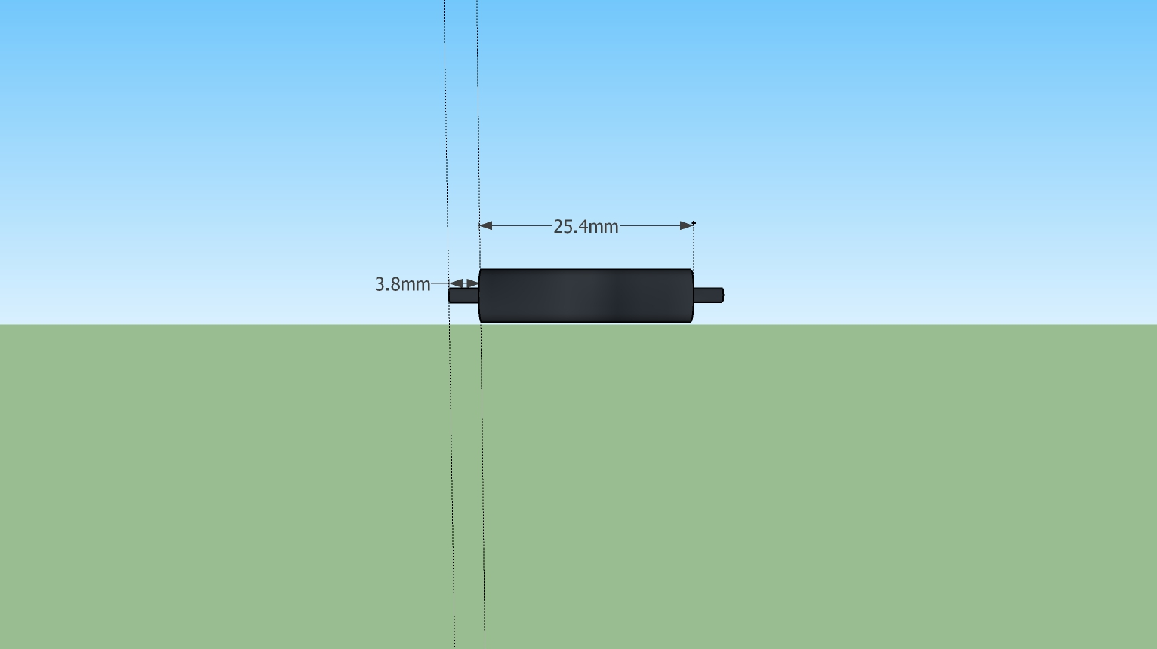
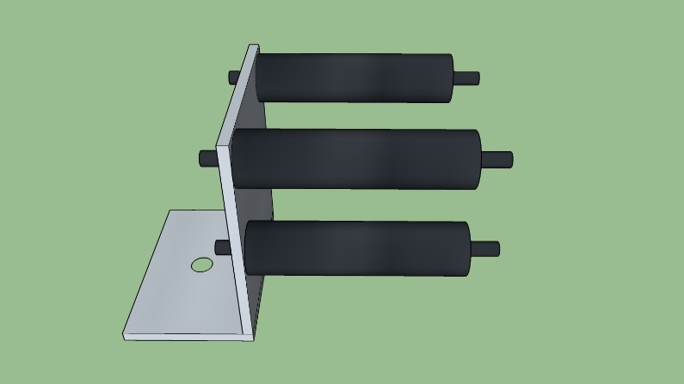
Mount Design
Nylon Stand-Offs

Slide 18
Requirement Motivation
Alternative Development Platform
Proposed Solution
The system shall consist of a team of at least 2 robots
The system shall have at least 1 aerial vehicle
Use ground robots to perform the following function:
Serve as a test bed for planning and perception algorithms
Map in parallel to quad copter

Slide 19
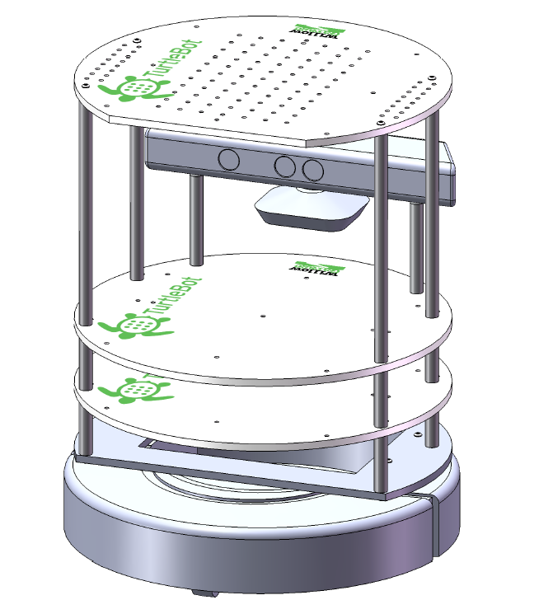
Ground Robot Description
Proposed to use TurtleBot with:
iRobot Create
Guidance
Odroid XU4
Kinect Mounting Hardware
Xtion Pro (optional)
FLiR sensor

Slide 20
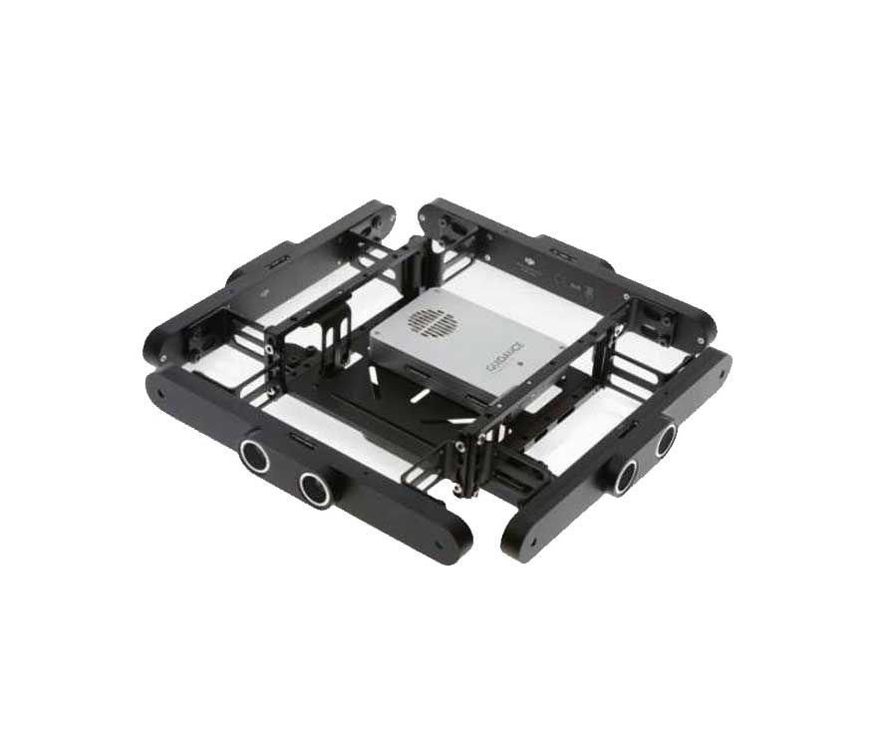
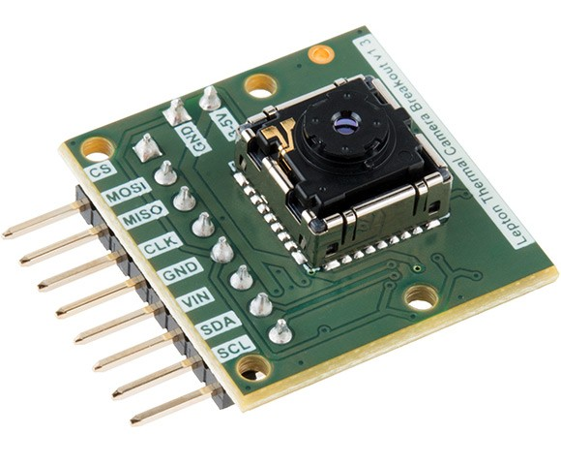
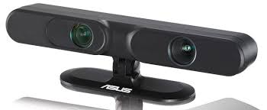
Ground Robot Architecture
IMU and Wheel Odometry
WiFi
Adapter
Guidance
Odroid XU4
Xtion
(optional)
FLiR
Power Distribution Board
Power Module
Motor
Battery

Slide 21
Ground Robot Comm.
Ground Station
Communicates between the on-board computer
Aerial Robot
Current position
Location of target (if found)
WiFi
WiFi
Odroid XU 4
Ubuntu 14.04
Runs Hector_Slam algorithms
Runs path planning algorithms for the ground
Acts as a task allocator (incase of multiple quadcopters)
Guidance
Provides depth map, grayscale images, and visual odometry for RTAB Map
FLiR
Provides IR images for human identification
Asus Xtion Pro (Optional)
Provides depth map, grayscale images, and visual odometry for RTAB Map
USB 3.0

Slide 22
Ground Robot Path Forward
Understanding the working of the current TurtleBot setup
Fabricate additional hardware to accommodate hardware additions
Implement path planning and perception algorithms
Integrate with aerial robot

Slide 23
Path Planning
Level 3 | Solution
The vehicles shall avoid unrecoverable collisions with obstacles | - PRM: Nodes are randomly placed in open space. - Voronoi: Nodes selected based on distance from obstacles - Collision-prone node connections are discarded.
The system shall plan vehicle trajectories through the environment | - Roadmap provides collision-free paths to most points in open space. - NN+2Opt/A* method provides a trajectory to visit most of the open space on the roadmap.
The aerial vehicle will maintain a minimum distance of 5 cm from obstacles | - PRM/Voronoi have the capability to configure the minimum distance from obstacles.
The system shall make all navigation decisions onboard. | - PRM/Voronoi both provide position set points in open space with collision-free paths between them.

Slide 24
2 Steps
Path Planning Solution
Step 1:
Roadmap Algorithm
Develop list of nodes within operating space
Exclude obstacles from list
Step 2:
Path Selection Algorithm
Select nodes which:
Lead from start -> goal
Inherently avoid obstacles due to step 1
Coverage of the entire space
Notes:
2 options for both

Slide 25
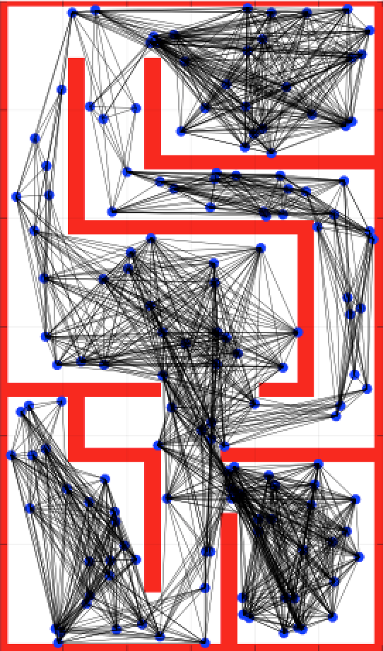
Roadmap (PRM)
Probabilistic Roadmap (PRM)
Inputs
Map grid with obstacles marked
Desired number of nodes
Desired maximum neighbor node distance
Process
Samples possible collision-free quadcopter configurations at random
Connect all nodes within the configured maximum neighbor distance
Discard any routes that intersect with obstacles
Outputs
Roadmap containing collision free nodes and edges representing possible vehicle configurations
Coverage across entirety of open space possible if number of nodes is sufficiently high

Slide 26
Roadmap (Voronoi)
Voronoi Node Generation
Inputs
Array of X and Y values that represent obstacles
Process
Delaunay triangulation
Draw circles through triangles (where vertices are the obstacles)
Connect centers of circles with lines
Outputs
Ordered list of polygon vertices representing points equidistant from obstacles

Slide 27
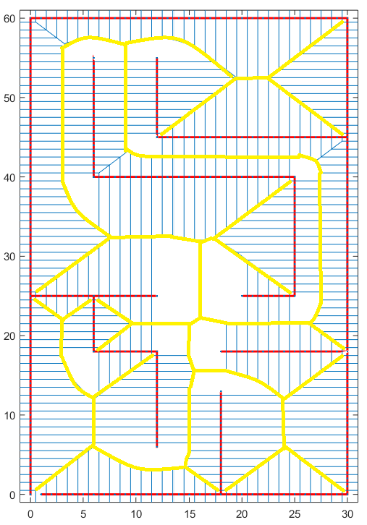
Roadmap (Voronoi)
Voronoi Node Generation
Inputs
Array of X and Y values that represent obstacles
Process
Delaunay triangulation
Draw circles through triangles (where vertices are the obstacles)
Connect centers of circles with lines
Outputs
Ordered list of polygon vertices representing points equidistant from obstacles

Slide 28
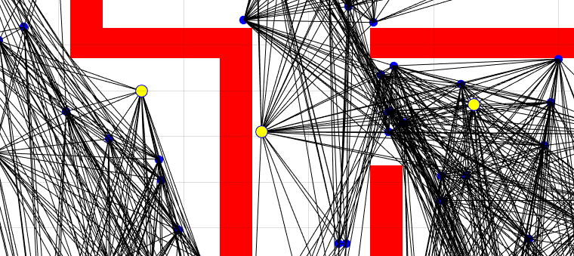
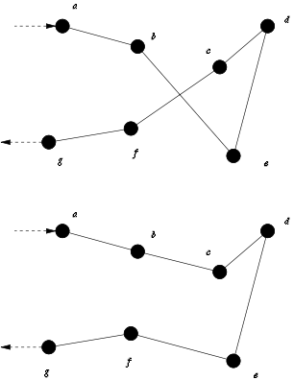
NN + 2 Opt
Nearest Neighbor + 2-Opt
Nearest Neighbors
Inputs
Auto-generated goal coordinates (a set of uniformly distributed points in free space)
PRM
Process
Build cost-weighted adjacency matrix for each goal coordinate
Compute path to the nearest goal for each goal
Optimize path using 2-Opt which removes unnecessary path crossover
2-Opt Example
Outputs
Position set points that efficiently traverse all goal coordinates.
Image courtesy of https://en.wikipedia.org/wiki/2-opt
Notes:
Advantage of 2opt?

Slide 29
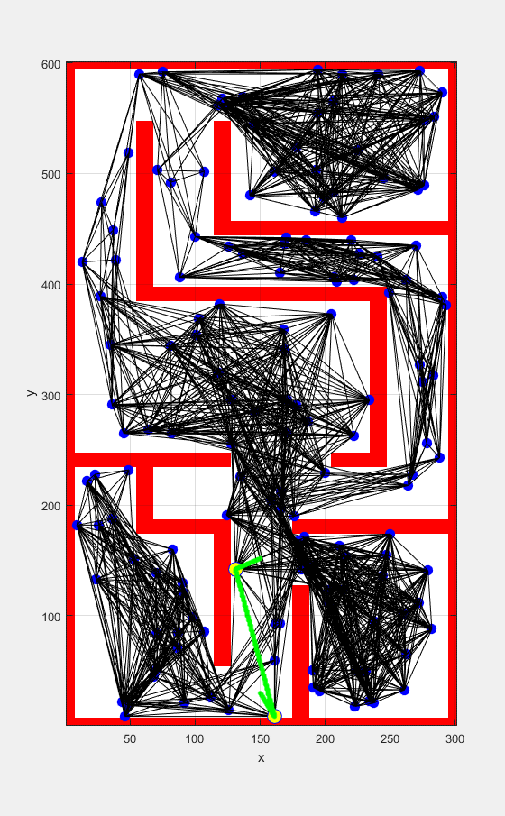
NN + 2Opt
Able to handle multiple goals
The computational effort increases as the number of goals (i.e. rooms) increases
Total area coverage is configurable
Depends on the granularity of auto-generated goal points
Goal points can be recalculated during the mission

Slide 30
PRM Performance
Processing time increases quadratically as the number of sampled configurations (nodes) increases
Increasing the number of nodes has diminishing returns for space coverage
Note: Performance based on Matlab computations

Slide 31
Voronoi Performance
Processing time is more or less linear
Note that our space is define in 340 (red *)

Slide 32
Flight Controls (FC)
Level 3 | Solution
The vehicles shall avoid unrecoverable collisions with obstacles | Waypoints around obstacles through communication with Pixhawk
The system shall plan vehicle trajectories through the environment | Waypoint generator running on ODROID
The vehicles shall move through the environment along planned trajectories to within 20cm RMS error of the planned trajectory when no obstacles are present. | PX4 Position Control system onboard Pixhawk with waypoint generation on ODROID. Control gains must be modeled to meet this requirement
The aerial vehicle will maintain a minimum distance of 5 cm from obstacles. | Waypoint generation around obstacles with a quick update on PX4 waypoints when obstacles are within distance thresholds
The system shall have power to sustain 10 minutes of search time with full payload | The system must travel at ~1.5 m/s on average. PX4 controllers support this velocity and has been flown up to
The system shall search an area of 50,000 ft²

Slide 33
FC Hardware
ODROID XU4 acts as onboard supervisory computer
Interfaces with planning and perception subsystems to feed set points to the autopilot
Pixhawk autopilot will be used to control the vehicle
Pixhawk was available, cheap enough to procure for multiple platforms, supports open source firmware for flexible software development, and legacy code and experience existed in house
Pixhawk supports position, velocity, or attitude set points for flexible interfacing options
Pixhawk supports the use of external vision position estimate solutions, such as the one provided from SLAM
Pixhawk with PX4 Firmware
ODROID XU4

Slide 34
FC Software
Robotic operating system was used to integrate the perception, planning, and flight control subsystems
ROS abstracts messaging layers, manages dependencies, is open source, supports heterogeneous code, and has existing code base to support each of the required subsystems
Built on a publish/subscriber and service/consumer architecture
Software is developed as interconnected nodes accomplishing various tasks
The flight control software was architected to maximize code reusability and modularity
Focus on standardizing interfaces
Support swapping nodes as new subsystem functionality becomes mature
Support future integration with software-in-the-loop simulations

Slide 35
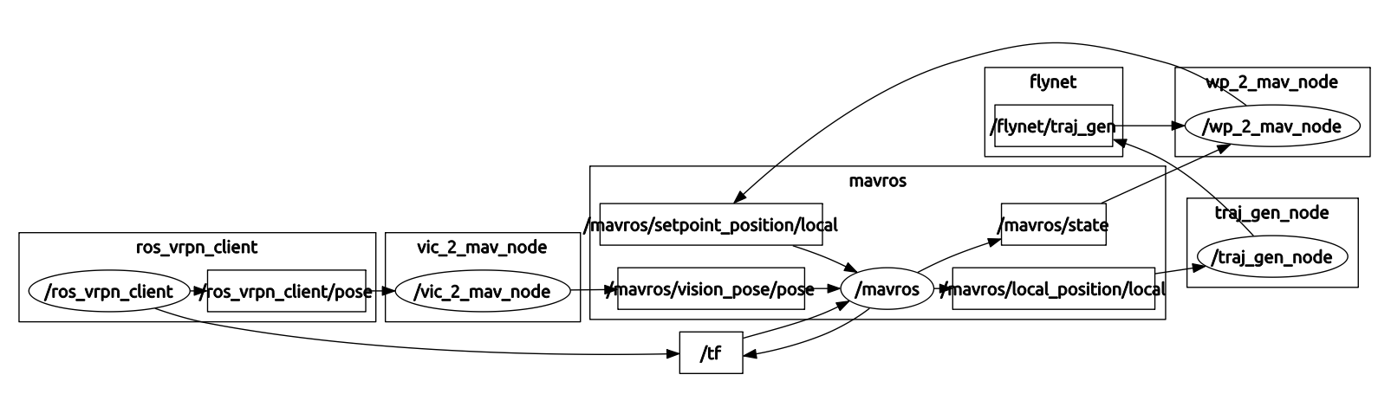
FC ROS Architecture
Core Flight Control Nodes
Coordinate Frame Translation
Trajectory Generation
Local Position Estimate

Slide 36
FC ROS Architecture
Core Flight Control Nodes
Perception Subsystem
Planning
Subsystem

Slide 37
Control Dynamics Modeling
6 DoF Model
First order model for motor dynamics
Ignores sensor dynamics
Path commands given as inertial x, y, z and yaw at time t
Model does not include:
Airframe drag
Blade flapping
Wall and boundary effects

Slide 38
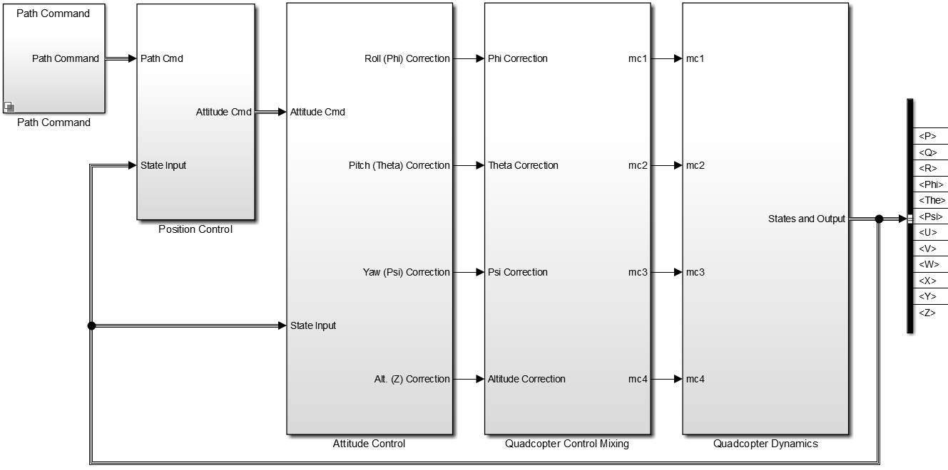
Control Dynamics Modeling
Altitude Step Response
Lateral Step Response
Yaw Step Response

Slide 39
Control Dynamics Modeling

Slide 40
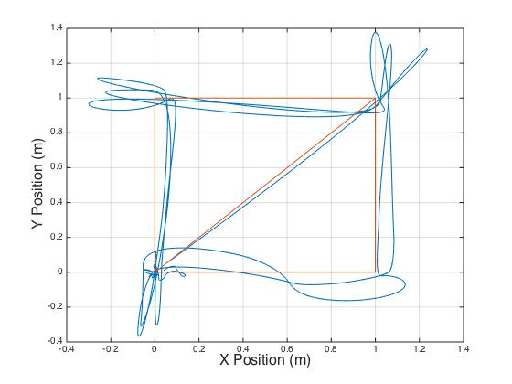
Flight Results

Slide 41
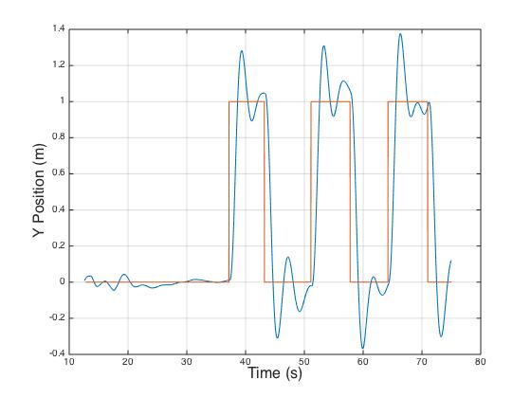
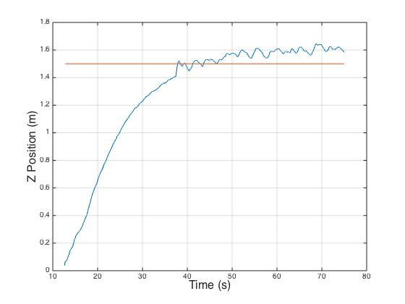
Flight Results
Flight Data for Square Trajectory with Altitude Hold

Slide 42
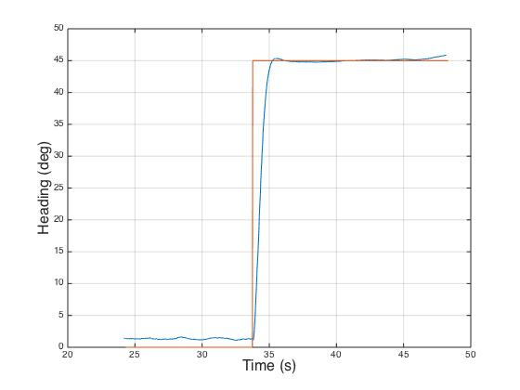
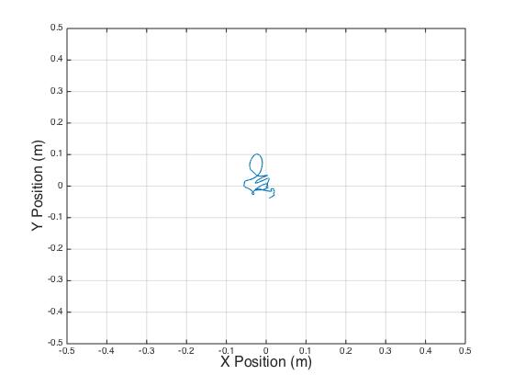
Flight Results
Flight Data for Yaw Step Command with Position hold

Slide 43
FC Path Forward
Tune control gains based on modeling results
Refine dynamics model from flight data
Integrate subsystems as they reach maturity
Integrate obstacle avoidance functionality in the ROS architecture
Develop software to overcome obstacles using altitude diversity
Utilize SITL simulations to verify flight control software functionality before hardware deployment

Slide 44
Perception
Level 3 | How is Requirement Satisfied
1.1.1 | The system shall have visual sensor(s) | Guidance cameras
1.1.2 | The system shall be capable of processing imagery | Guidance and software pipelines
1.2.1 | The system shall avoid unrecoverable collisions with obstacles | Obstacle detection via Guidance
1.2.2 | The system shall plan vehicle trajectories through the environment | Map production from RTABMap
Level 3 | How is Requirement Satisfied
2.1.1 | The PPU shall estimate target position to within 0.5 m | Software stereo pipeline's depth image coupled with RTABMap position estimate
4.1.2 | The system shall perform perception onboard | Guidance + RTABMap

Slide 45
Design Choices
Major Design Choices:
Custom vs Off-The-Shelf SLAM Package
Underlying algorithmic options
Sparse vs Dense
Loop closure support
Image processing choices:
Onboard
Auxiliary processor
Image sensor choices:
Monocular
Visual + Depth
Stereo pair
Additional sensor options
Ultrasound
Scanning laser
Laser altimeter

Slide 46
Custom vs. Prebuilt
Given timeline and team resources, development of a custom SLAM solution was not feasible
Turned to available software packages for their support of popular varieties of SLAM:
RGBDSlam
RTABMap
CCNYSlam
LSDSlam
Package determines sensors required and potential limitations
Loop closure determined to be a necessary feature to support operations in larger spaces
Necessary to have immediate position output for use in control system
Required to provide reasonable performance on a CPU that can be flown as payload

Slide 47
SLAM Design Choice
Design choice: RTABMap
Demonstrated capability aboard ARM SOCs
Provides for loop closure and map generation
Able to use a variety of sensor inputs (RGB-D / stereo / laser)
Uses sparse methods with a keyframe approach to minimize growth of map over large areas

Slide 48
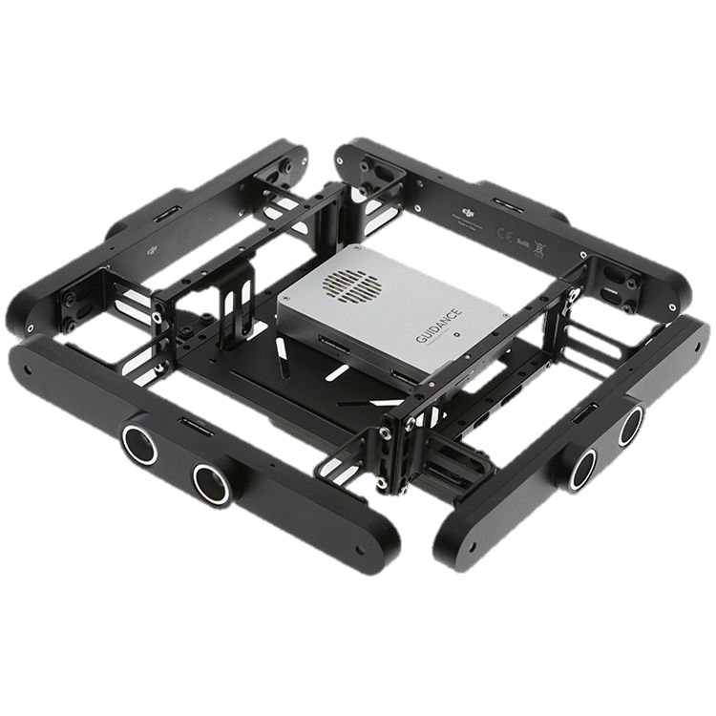
Onboard vs. Auxiliary
RTABMap requires an odometry source of some sort
External odometry could offload a major source of CPU utilization
Capable of generating odometry from monocular or stereo sensors
Design Choice: Guidance
Provides an external auxiliary processor to compute odometry, as well as sychronized global shutter stereo pairs
Includes ultrasound sensors as a bonus
Available as a turn-key solution

Slide 49
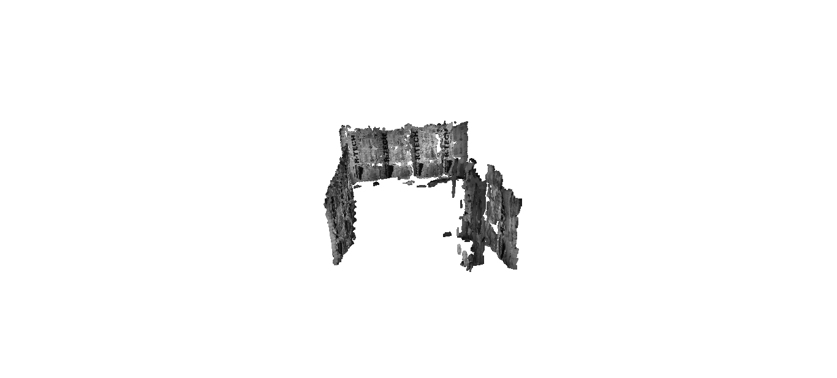
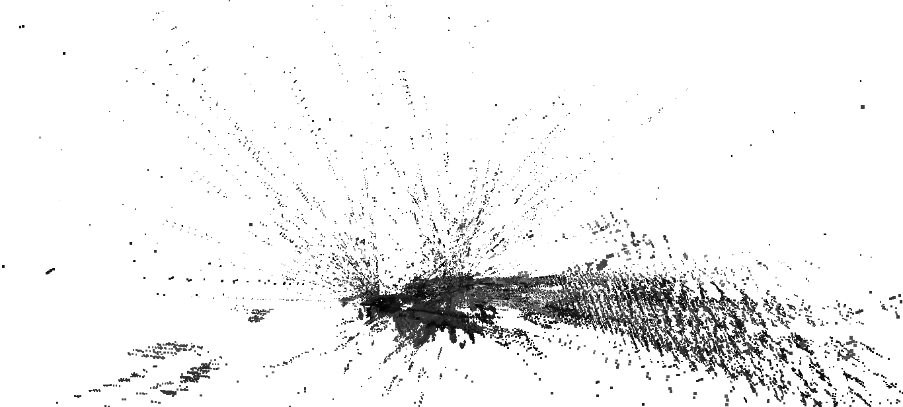
Camera Choice
RTABMap requires imagery input, either as a RGB-D or a stereo pair
Design choice: Stereo Pair
Depth maps produced by Guidance show poor performance, related to stereo pipeline algorithm parameters that can't be changed
Software stereo pipeline available to produce depth maps for use in target registration to 3D coordinates
Map produced by RGB+Depth
Map produced by stereo pair

Slide 50
Additional Sensors
Design choice: Laser altimeter
Guidance provides ultrasounds for coarse object detection and coarse altitude estimation
As testing proceeds, the laser altimeter may become necessary to ensure safe autonomous takeoffs and landings

Slide 51
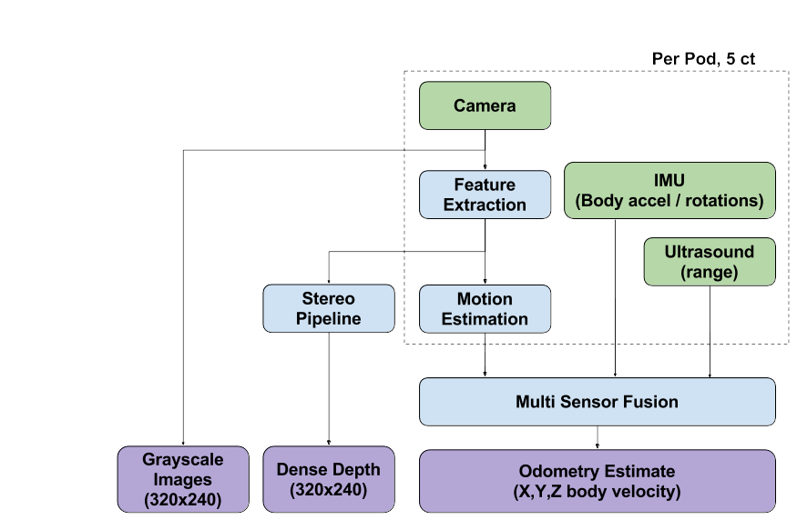
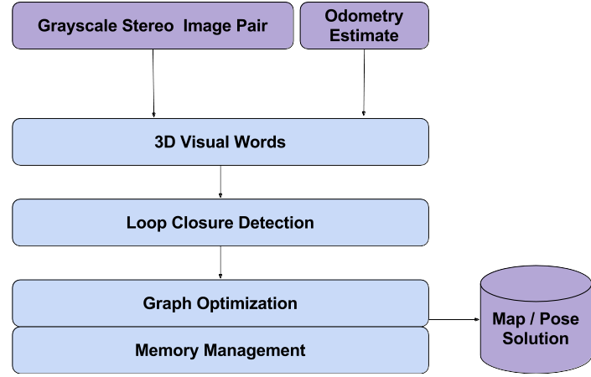
Additional Sensors
Guidance
RTAB Map

Slide 52
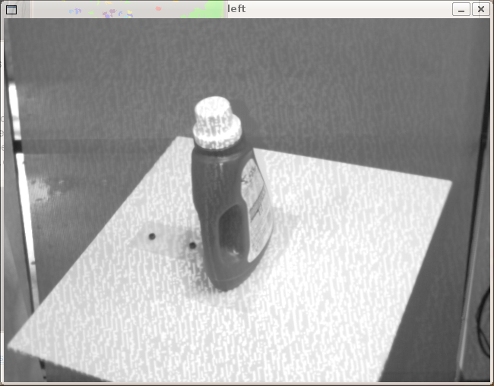
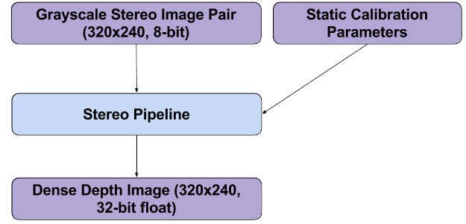
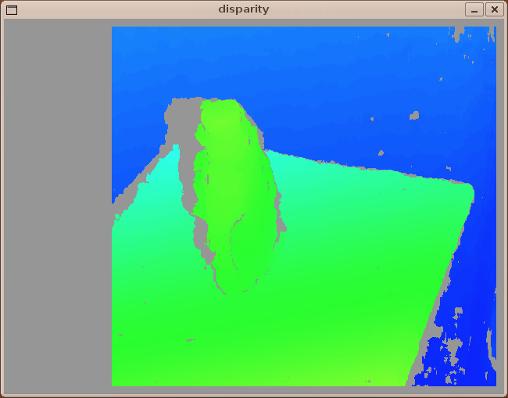
Software Stereo Block Diagram

Slide 53
Target ID and Tracking
Level 3 | How is Requirement Satisfied
The system shall have visual sensor(s) | FLiR Lepton LWIR Camera
The system shall be capable of processing imagery | OpenCV
The system shall locate individual targets with 95% probability of detection | Use of LWIR instead of visual
The system shall identify human targets within 5 meters | Sufficient resolution to detect humans at 5 m
Level 3 | How is Requirement Satisfied
The PPU shall estimate the target position to within 0.5 meters | As long as depth map is accurate enough, this is not a problem
Each PPU shall estimate at least 2 visually identified targets | Number of tracked targets is configurable
Each PPU shall maintain estimates of all confirmed target tracks | Estimates are published to ROS nodes
PPUs shall process target estimates at 10 Hz | Small images and simple algorithm = very fast processing (Close to real time with HD images)

Slide 54
Design Choices
Major Design Choices:
Sensor Type
Visual Spectrum Camera
IR Spectrum Camera
Stereo
Monocular
Tracking Algorithm
Alternative Multiple Models
Multiple Hypothesis Tracker
Discrimination
Simple Masking Tracker

Slide 55
Design Choices
Major Design Choices:
Sensor Type
Visual Spectrum Camera
IR Spectrum Camera
Stereo
Monocular
Tracking Algorithm
Alternative Multiple Models
Multiple Hypothesis Tracker
Discrimination
Simple Masking Tracker
Performance varies greatly with lighting conditions.
Increased complexity

Slide 56
Design Choices
Major Design Choices:
Sensor Type
Visual Spectrum Camera
IR Spectrum Camera
Stereo
Monocular
Tracking Algorithm
Alternative Multiple Models
Multiple Hypothesis Tracker
Discrimination
Simple Masking Tracker
Provides great contrast between human target and background
Simplifies target identification problem
Not sensitive to lighting conditions

Slide 57
Design Choices
Major Design Choices:
Sensor Type
Visual Spectrum Camera
IR Spectrum Camera
Stereo
Monocular
Tracking Algorithm
Alternative Multiple Models
Multiple Hypothesis Tracker
Discrimination
Simple Masking Tracker
Depth may be provided by SLAM sensors

Slide 58
Design Choices
Major Design Choices:
Sensor Type
Visual Spectrum Camera
IR Spectrum Camera
Stereo
Monocular
Tracking Algorithm
Alternative Multiple Models
Multiple Hypothesis Tracker
Discrimination
Simple Masking Tracker
Time ordered history of position of target is not required
No need to discriminate between multiple targets.

Slide 59
Design Choices
Major Design Choices:
Sensor Type
Visual Spectrum Camera
IR Spectrum Camera
Stereo
Monocular
Tracking Algorithm
Alternative Multiple Models
Multiple Hypothesis Tracker
Discrimination
Simple Masking Tracker

Slide 60


FLiR Sensor
Design Solution: FLiR Lepton LWIR Camera with Image Masking and Contour Tracking
FLiR Lepton on Breakout Board
FLiR Lepton on Quarter for Scale

Slide 61
FLiR Sensor
Design Solution: FLiR Lepton LWIR Camera with Image Masking and Contour Tracking
Specifications:
LWIR sensor: 8-14 μm
51-deg HFOV, 63.5-deg diagonal FOV
80 x 60 pixels
Thermal sensitivity <50 mK
MIPI and SPI video interfaces
I2C control interface
Power draw <160 mW
8.6 Hz frame rate
Mass 0.55 g

Slide 62

Tracking Algorithm Overview

Slide 63

Tracking Algorithm Overview
Masking +
Morphology

Slide 64
Tracking Algorithm Overview
Contour Detection
And Selection

Slide 65


Algorithm Performance
Matlab was used to generate simulate FLiR LWIR images and Guidance depth map images
These images were processed to determine sensitivity to noise and target position
Simulated Human-Sized Target at 5m
Simulated 80x60 FLiR Image
Simulated 320x240 Guidance
Depth Map

Slide 66
Algorithm Performance
Error due to noise in Guidance depth map was on the order of the noise itself
Error due to position in frame is negligible
Simulated Human-Sized Target at 5m
Simulated 80x60 FLiR Image
Simulated 320x240 Guidance
Depth Map

Slide 67

ROS Integration
Stereo Depth Map Algorithm

Slide 68

Test Plan

Slide 69
Test Plan
Notes:
Fell behind schedule
Spent more time designing system then planned
Designs changed
Component issues
Talk about the most important test from this semester, and the two most important tests for next semester.

Slide 70
Test Plan

Slide 71

Final Test Demo
Start with a known floor plan
2 ft.
2 ft.
Hallway
Notes:
Designed for this semester
Pushed back to next semester
Showcase functionality of the system
Performed in Fleming lab

Slide 72
Final Test Demo
Start with a known floor plan
Target placed into area in unknown location
2 ft.
2 ft.
Hallway
Target

Slide 73
Final Test Demo
Start with a known floor plan
Target placed into area in unknown location
“Roadblocks” and a “Complete Block” added to simulate debris or obstacles
2 ft.
2 ft.
Hallway
“Roadblock”
Target
“Complete Block”

Slide 74
Final Test Demo
Start with a known floor plan
Target placed into area in unknown location
“Roadblocks” and a “Complete Block” added to simulate debris or obstacles
Also have a known entry/exit point
2 ft.
2 ft.
Hallway
“Roadblock”
Target
“Complete Block”
Entry/Exit Point

Slide 75
Final Test Demo
System will autonomously fly and map entire space
2 ft.
2 ft.
Guidance Sensor
SLAM Algorithm
Hallway
“Roadblock”
Target
“Complete Block”
Entry/Exit Point

Slide 76
Final Test Demo
System will autonomously fly and map entire space
Planning subsystem will help avoid obstacles and recalculate trajectory
2 ft.
2 ft.
Hallway
“Roadblock”
Guidance Sensor
Obstacle Detection
Path Planning
Target
“Complete Block”
Entry/Exit Point
!

Slide 77
Final Test Demo
System will autonomously fly and map entire space
Planning subsystem will help avoid obstacles and recalculate trajectory
Target will be identified and located in the space
2 ft.
2 ft.
Hallway
“Roadblock”
Target
“Complete Block”
Guidance Sensor
FLIR Camera & Target ID
Entry/Exit Point

Slide 78
Final Test Demo
System will autonomously fly and map entire space
Planning subsystem will help avoid obstacles and recalculate trajectory
Target will be identified and located in the space
System will return to exit point to deliver map
2 ft.
2 ft.
Hallway
“Roadblock”
Target
“Complete Block”
Entry/Exit Point

Slide 79

Final Test Demo
Building specs:
4’ high walls made of 4’x8’ foam insulation paneling
Walls held upright with wooden frames
Doorframes will have extra reinforcements
Wall design has been tested and proves to be viable

Slide 80

Budget
Currently Spent:
$3000.00 / 20.0%
Materials bought
New quadrotor
3 ODROID XU4s
Demo materials
Lumber, foam
DJI Guidance

Slide 81
Next Semester
Currently Spent:
$1855.00 / 12.4%
Previous spending:
Quadrotor platform
Several single board computers (ODROID XU4)
Planned Spending:
Secondary platform:
Estimated to be $3000 per platform

Slide 82
Thanks to Dr. Eric Frew, Joe Tanner, and Zohaib Mian for support and guidance

Slide 83
References
http://wiki.ros.org/stereo_image_proc/Tutorials/ChoosingGoodStereoParameters
http://www.sekidorc.com/pdf/Guidance_UserManual_en_v1.2_150803.pdf
http://www.hobbyking.com/hobbyking/store/__61487__AlienCopter_Bee_full_Carbon_KIT_W_Clean_and_Dirty_System_and_PDB_W_BEC.html
http://www.hobbyking.com/hobbyking/store/__19626__FrSky_TFR4_4ch_2_4Ghz_Surface_Air_Receiver_FASST_Compatible.html
http://www.hardkernel.com/main/products/prdt_info.php
https://www.sparkfun.com/products/13233
https://developer.dji.com/guidance/
https://www.asus.com/3D-Sensor/Xtion_PRO/
https://store.3drobotics.com/products/3dr-pixhawk

Slide 84
Questions?

Slide 85
Backup
Notes:
Incomplete Matlab algorithmic demonstration

Slide 86
Backup
Probabilistic Roadmap (PRM)
Creates roadmap based on randomly sampled quadcopter configurations in open space.
Nearest Neighbor (NN) with 2-Opt
NN: Traverses roadmap goals by minimizing the total distance traveled from one node to the next.
2-Opt: Optimizes path takes a route that crosses over itself and reorders it so it does not.

Slide 87

Backup
Probabilistically complete
Chance to find route increases as number of nodes increases
Flexible and robust
Collision avoidance threshold distance is configurable
Number of sample nodes is configurable
Maximum node neighbor distance configurable
Re-plan only depends on updated map grid
Certain geometries where straight line connections cannot be made are difficult to navigate

Slide 88
Backup
Able to handle multiple goals
The computational effort increases as the number of goals (i.e. rooms) increases
Total area coverage is configurable
Depends on the granularity of auto-generated goal points
Goal points can be recalculated during the mission

Slide 89
Backup
Voronoi path generation
Generates nodes which are equidistant from obstacles
A* search
Least cost node selection
Cost = g(n) + h(n)
g(n) = known cost (previously traversed)
h(n) = estimate of node -> goal distance

Slide 90
Backup
Fewer nodes to evaluate than probabilistic methods
Optimum obstacle margin
Paths automatically as far from obstacles as possible
Open spaces are often node sparse
Depending on size of room, could require node addition to fill out space

Slide 91
Backup
Processing time increases quadratically as the number of goals increases
Goals are auto-generated for uniform coverage of the open space
Note: Performance based on Matlab computations

Slide 92

Backup
FLiR - Odroid Integration

